Slide 1
Emotion detection to upgrade Customer Experience
Team Members Panel Number:9
Project Advisor: Mr.Sabarish B.A (Asst. Prof) /CSE
S. No | Reg. No | Name of the Student | Section
1 | CB.EN.U4CSE18404 | Abisheck Kathirvel | CSE E
2 | CB.EN.U4CSE18419 | E V K Praneeth | CSE E
3 | CB.EN.U4CSE18450 | Rohith Rajesh | CSE E
4 | CB.EN.U4CSE18453 | Sanjith Ragul V | CSE E

Slide 2
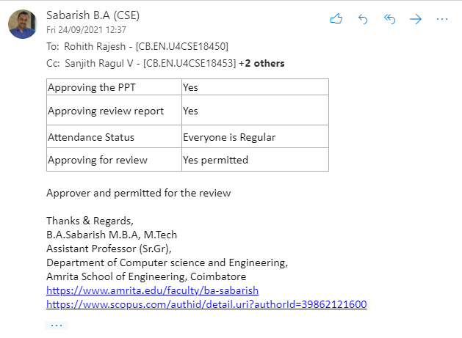
Guide Approval Mail

Slide 3
Problem Statement
To provide an improved customer service experience by emotion-based call routing using Sentiment Analysis in a chat and automatic grading for the customer service executives using Speech Emotion Recognition.

Slide 4
Abstract
Growing technological development business platforms have shifted to web and cloud-based environments. Every customer needs privacy with respect to the purchases and services they seek. All business centers provide customer service support to clarify their queries in services or products. The present feedback system uses QA which ends in a biased feedback that leads to inaccurate customer experience. Interaction between the customer and executive gets affected by various reasons including inappropriate executive, extended wait time, etc.
This project provides a framework that identifies the mood/emotion of the customer based on the initial chat query in a chat application and then uses sentiment analysis and routes the request to the appropriate technical expert to solve the issue which in turn improves the customer experience. After the call is established, using speech recognition the system identifies the emotion of the customer for the clarification/service provided by the person and grades them automatically.

Slide 5
Abstract
This framework for improving customer experience through sentiment analysis and emotion detection involves two phases: emotion-based call routing and auto-grading of service professionals. The project proposes a Convolutional Neural Network(CNN) based architecture for Speech Emotion Recognition and classifies speech into angry, neutral, disappointed or happy. The outcome of this proposed system is to upgrade the customer experience by analyzing the calls at the customer care center. This system can also be used in various fields other than feedback systems like in the diagnosis of physiological disorders and counseling as emotion is an important topic in psychology and neuroscience.
Keywords Sentiment analysis, Emotion detection, Machine learning, NLP, Customer service, Speech recognition

Slide 6
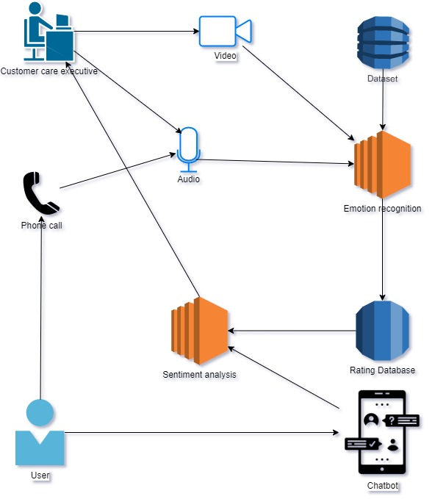
Architecture diagram

Slide 7
REVIEW 0
Comments | Action Taken
Find a combined audio-visual dataset | Found a research paper that uses a combined dataset Contacted them and waiting for their consent

Slide 8
Literature survey (Existing system)
S. No | Author | Full title of paper with Year | Inference from the paper(based on methodology, technology) | Open Problem(for your proposed work)
1 | M. Aravind Rohan | Emotion Recognition Through Speech Signal Using Python 2020 | Segmentation of audio signals(duration) Comparison of different classifiers to detect emotions using MFCC features in speech samples | -
2 | Linqin Cai Jiangong Dong Min Wei | Multi-Modal Emotion Recognition From Speech and Facial Expression Based on Deep Learning 2020 | CNN and LTSM based multimodal emotion recognition model Pre-Processing for face and speech data and feature fusion | Improve feature fusion methods Make a system that focuses more on privacy
3 | Wenjing Han Tao Jiang Yan Li Björn Schuller Huabin Ruan | Ordinal Learning For Emotion Recognition In Customer Service Calls 2020 | End to End modelling using Ordinal learning under a Consistent Rank Logits (CORAL) based deep learning framework Data cleaning techniques | -
Notes:
More papers needed

Slide 9
Literature survey (Existing system)
S. No | Author | Full title of paper with Year | Inference from the paper(based on methodology, technology) | Open Problem(for your proposed work)
4 | Kim Y. Levy J. Liu Y. | Speech Sentiment and Customer Satisfaction Estimation in Social Bot Conversations | Use of acoustic and lexical information in understanding the relationship between CSAT and sentiment scores | Filtering irrelevant data from the features selected
5 | Anvar Shathik Krishna Prasad | A Literature Review on Application of Sentiment Analysis Using Machine Learning Techniques | Different techniques for machine learning used in the analysis of emotions Combing algorithms like SVM and logistic regression detecting positive and negative feedbacks | Performing and determining the ideal attributes by feature selection
Notes:
More papers needed

Slide 10
Modularisation
S. No | Module | Module description
1 | Speech Emotion Recognition | Using speech recognition, the system identifies the emotion of the customer for the clarification/service provided by the person and grades them automatically
2 | Sentiment Analysis | Identifies the mood/emotion of the customer based on the initial chat query in a chat application
3 | Salesperson video-based emotion recognition | Using video emotion recognition
4 | Integrating the two modules with chat application and calling system | Combining SER and Sentiment analysis into a real-world system
Notes:
More papers needed

Slide 11
Responsibilities of Team Members
• Rohith Rajesh - Explore pre-processing techniques, grading based on emotion
recognition
• Sanjith Ragul V- Work on ML models for speech emotion recognition and compare
exisiting models
• Abisheck Kathirvel- Feature extraction and ML models for emotion recognition
• E V K Praneeth- Visualization, exploratory data analysis
Notes:
More papers needed

Slide 12
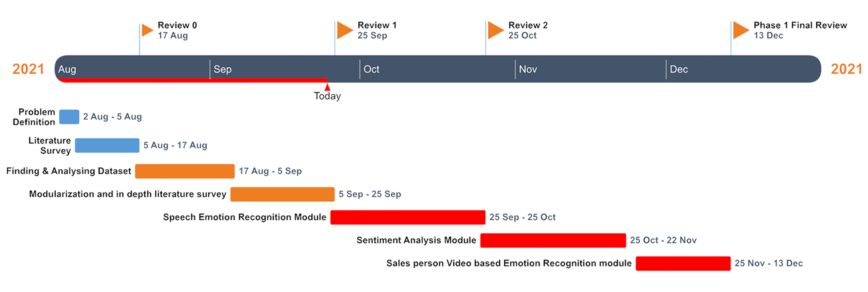
Timeline diagram

Slide 13
Speech Emotion Recognition
Explored about Mel Frequency Cepstral Coefficient(MFCC), Mel Spectrogram Frequency(MEL) feature and how to extract them from voice dataset.
Explored Pre-Processing techniques like Sampling frequency, Compression and expansion of signal called companding and making blocks to buffer waveforms
Worked with audio data and we are waiting for approval of the dataset owner to use the audio-visual dataset which would be more appropriate.

Slide 14
References
Anvar Shathik, J. and Krishna Prasad, K., A Literature Review on Application of Sentiment Analysis Using Machine Learning Techniques. In 2020 International Journal of Applied Engineering and Management Letters(IJAEML) (ISSN. 2581-7000)
Cai, L., Dong, J. and Wei, M., 2020, November. Multi-Modal Emotion Recognition From Speech and Facial Expression Based on Deep Learning. In 2020 Chinese Automation Congress (CAC) (pp. 5726-5729). IEEE.
Rohan, M.A., Swaroop, K.S., Mounika, B., Renuka, K. and Nivas, S., 2020, October. Emotion Recognition Through Speech Signal Using Python. In 2020 International Conference on Smart Technologies in Computing, Electrical and Electronics (ICSTCEE) (pp. 342-346). IEEE.
Kim, Y., Levy, J. and Liu, Y., 2020. Speech Sentiment and Customer Satisfaction Estimation in Socialbot Conversations. arXiv preprint arXiv:2008.12376.
Han, W., Jiang, T., Li, Y., Schuller, B. and Ruan, H., 2020, May. Ordinal learning for emotion recognition in customer service calls. In ICASSP 2020-2020 IEEE International Conference on Acoustics, Speech and Signal Processing (ICASSP) (pp. 6494-6498). IEEE.

Slide 15
THANK YOU

